Slide 1
PHYSIC 3 – RIVIEW Final examination

Slide 2
Contents
01
03
02
04
Chapter 4: Magnetism
Chapter 5: Electromagnetic induction
Our academic areas
QnA

Slide 3
01
Chapter 4:Magnetism

Slide 4
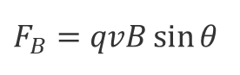

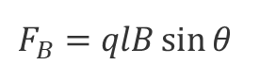
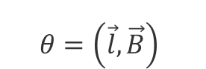


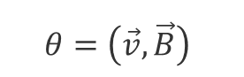
4.1: Magnetics Forces
$$F_{B}$$
Crucial Formulation:
Charge
$$θ$$
Wire
$$θ$$
$$F_{B}=qvB\sin{θ}$$
$$θ=\left(\vec{v},\vec{B}\right)$$
$$F_{B}=qlB\sin{θ}$$
$$θ=\left(\vec{l},\vec{B}\right)$$
$$F=ma$$

Slide 5

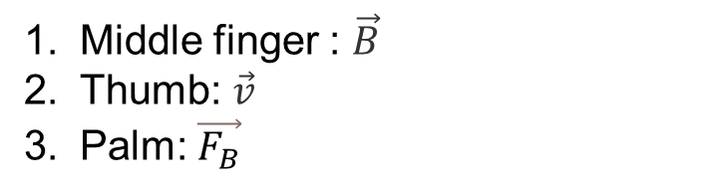

4.1: Magnetics Forces
Right hand’s rule:
Middle finger : $\vec{B}$
Thumb: $\vec{v}$
Palm: $\vec{F_{B}}$
Practice

Slide 6
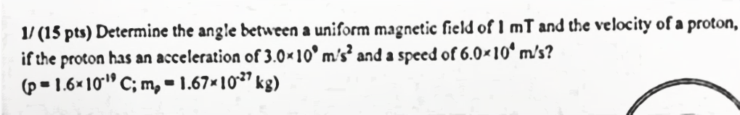

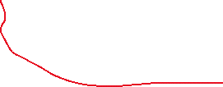
4.1: Magnetics Forces

Slide 7
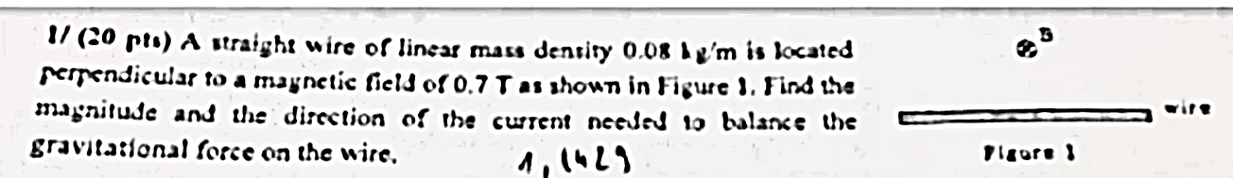
4.1: Magnetics Forces

Slide 8
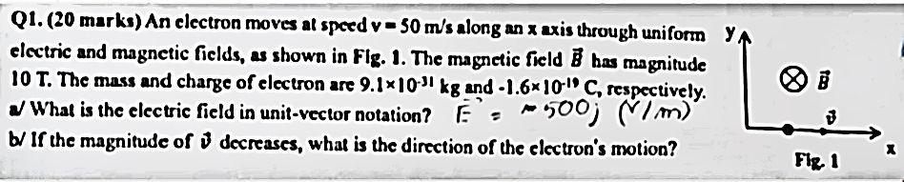

4.1: Magnetics Forces

Slide 9
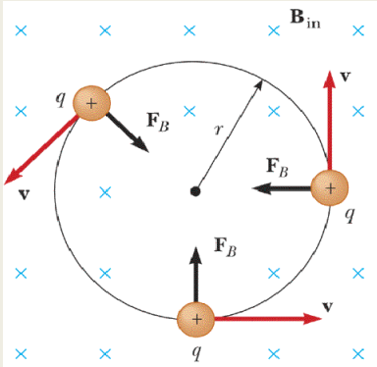
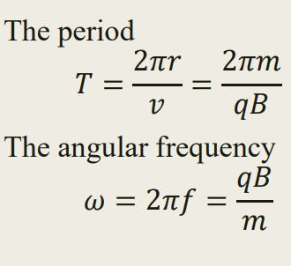
4.1: Motion of Charge Particle in a Magnetic Field

Slide 10
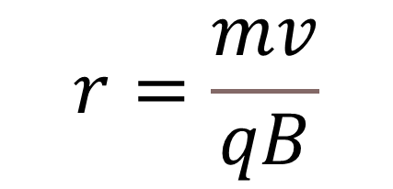
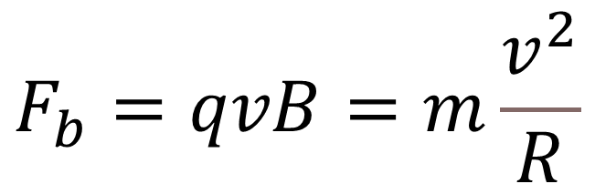
4.2: Motion of Charge Particle in a Magnetic Field
$$F_{b}=qvB=m\frac{v^{2}}{R}$$
$$r=\frac{mv}{qB}$$

Slide 11
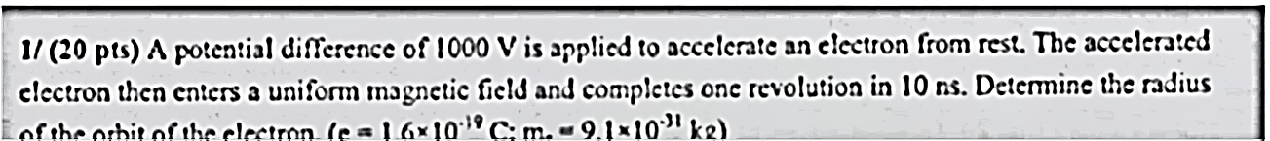
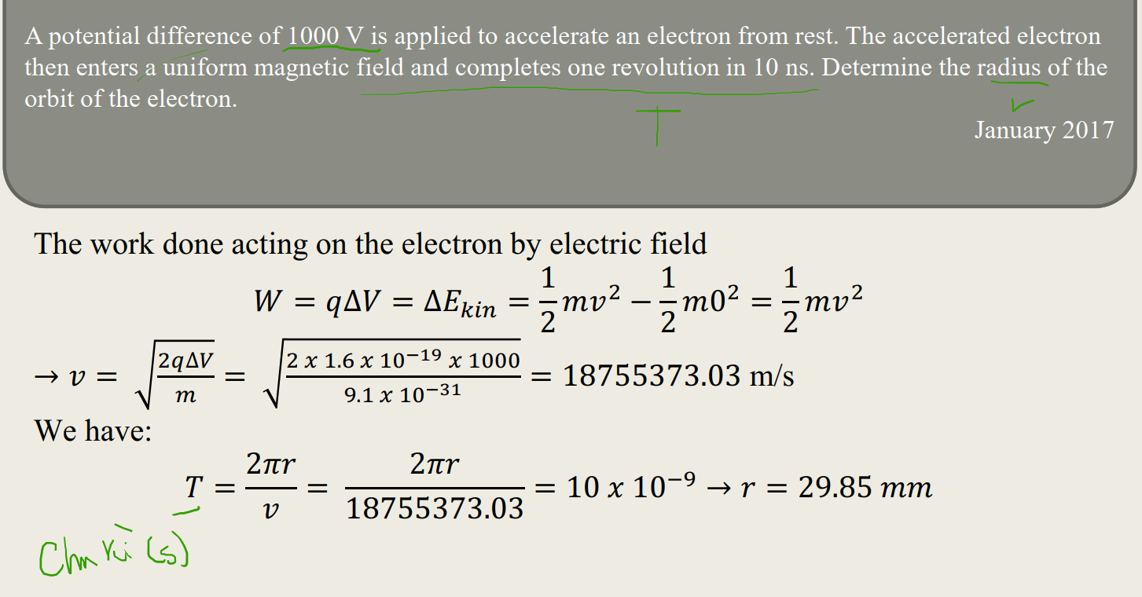

4.1: Motion of Charge Particle in a Magnetic Field

Slide 12
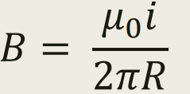
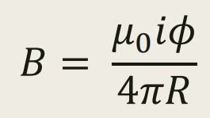
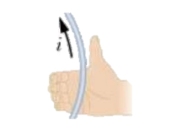
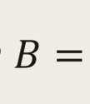
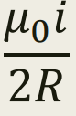

4.3: Magnetic field in current
straight wire:
$$rad$$
circular arc:
full circle:

Slide 13
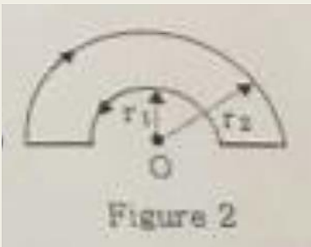
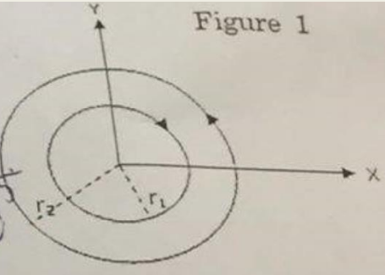




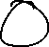
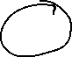
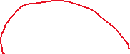
4.3: Magnetic field in current

Slide 14
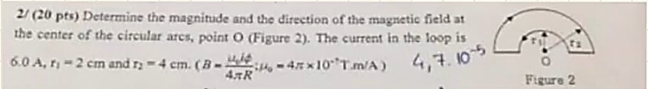
4.3: Magnetic field in current

Slide 15

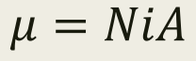
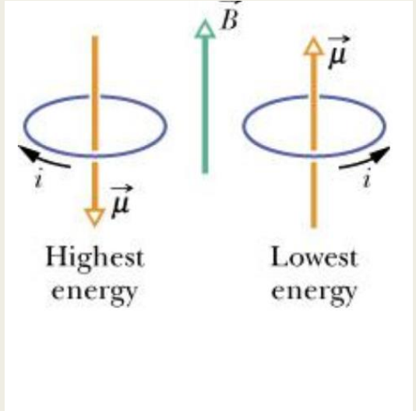
4.4: Torque on current carrying-wire
Number of turns
Current
Area enclosed

Slide 16
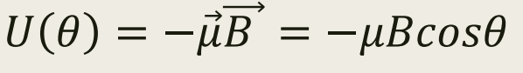

4.4: Magnetics Potential Energy
$$θ?$$

Slide 17
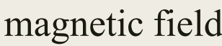
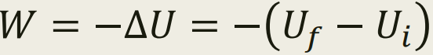



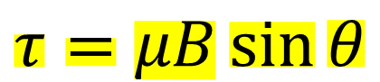
4.4: Magnetics Potential Energy
$$τ=μB\sin{θ}$$

Slide 18
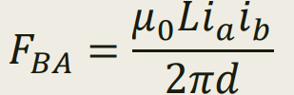
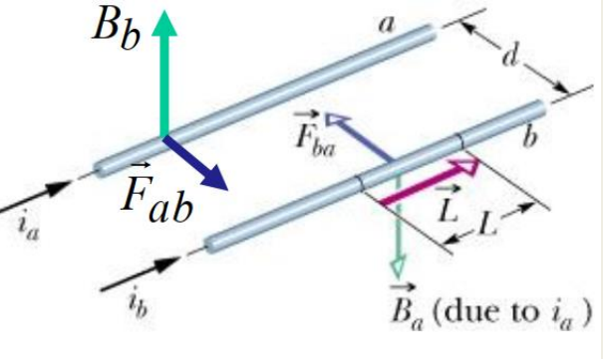
4.4: Two Parallel wire
The interaction between two parallel wires involves a force that attracts the currents towards each other.
Conversely, when the currents in the wires are anti-parallel or flowing in opposite directions, the force acts to push the currents apart.

Slide 19
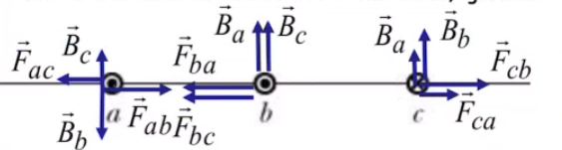
4.4: Two Parallel wire

Slide 20
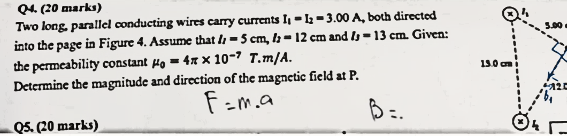


4.4: Two Parallel wire

Slide 21
02
Chapter 5: ELECTROMAGNETIC INDUCTION

Slide 22
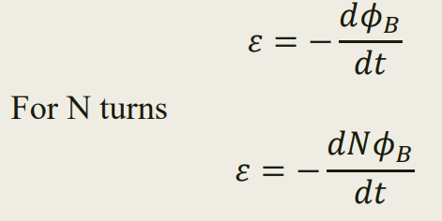
5.1 The magnetic flux through the loop

Slide 23
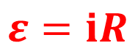
The magnetic flux through the loop
$$ε=ⅈR$$
$$\vec{B}\left(magnetics field\right) makes area$$

Slide 24
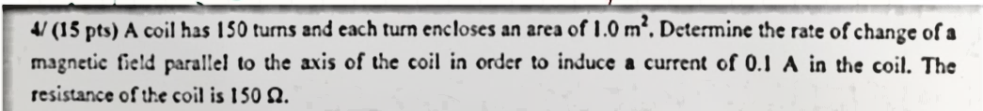
The magnetic flux through the loop

Slide 25
03
Chapter 6: ALTERNATING CURRENT

Slide 26
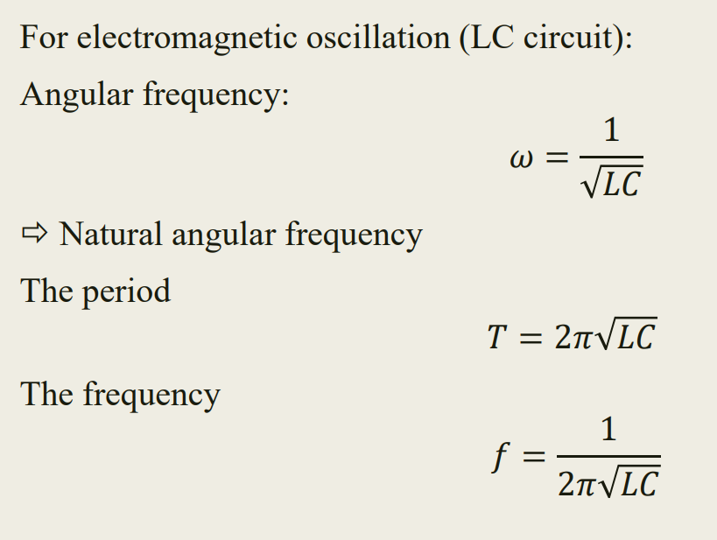
6.1: LC circuit

Slide 27
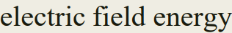
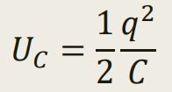
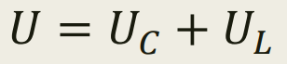
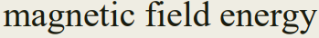
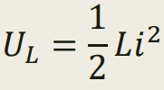
6.1: LC circuit

Slide 28
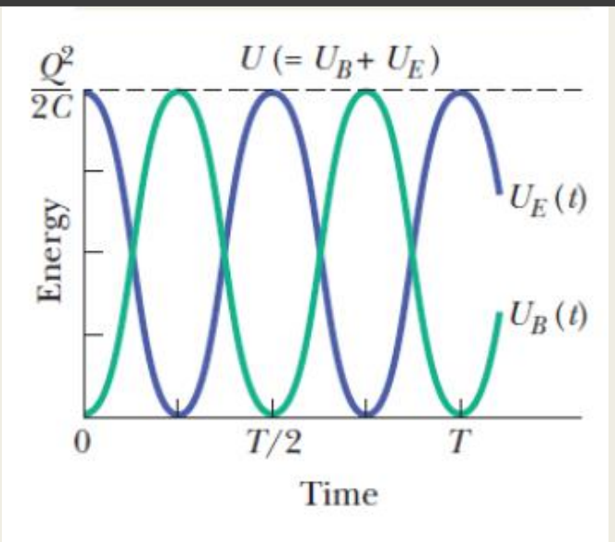
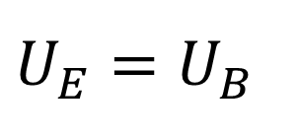
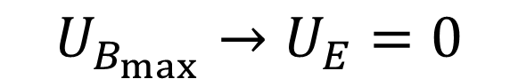
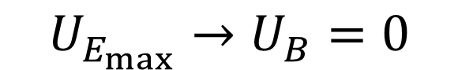
6.1: LC circuit
$$U_{E_{max}}→U_{B}=0$$
$$U_{B_{max}}→U_{E}=0$$
$U_{E}=$ $U_{B}$
Both max →

Slide 29
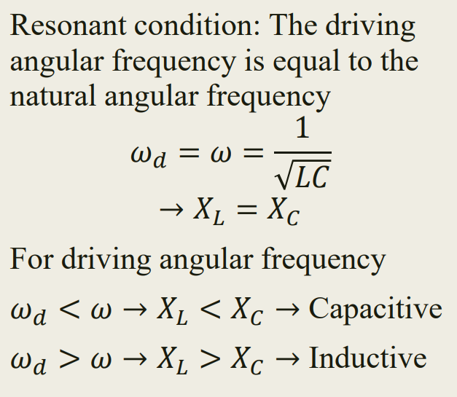





6.2: RLC circuit
$$Impedance: z=\sqrt{R^{2}+{\left(x_{L}−x_{l}\right)}^{2}}$$
$$x_{L}=ωL$$
$$x_{c}=\frac{1}{ωc}$$
Current amplitude: $I=\frac{ε}{z}=\frac{ε}{\sqrt{R^{2}+{\left(x_{L}−x_{c}\right)}^{2}}}$
$$The phase constant: tan{φ}=\frac{x_{L}−x_{c}}{R}$$

Slide 30





6.2: RLC circuit
$$z$$
$$x_{L}−x_{c}$$
$$x_{c}−x_{L}$$
$$z$$

Slide 31



6.2: RLC circuit

